Slide 1





Desafio
Desafio: Gere planos de ação a partir de análises com SQL
Este template visa orientar um formato para entrega, você pode alterá-los se quiser! Apenas mantenha as informações nos slides indicados!

Slide 2

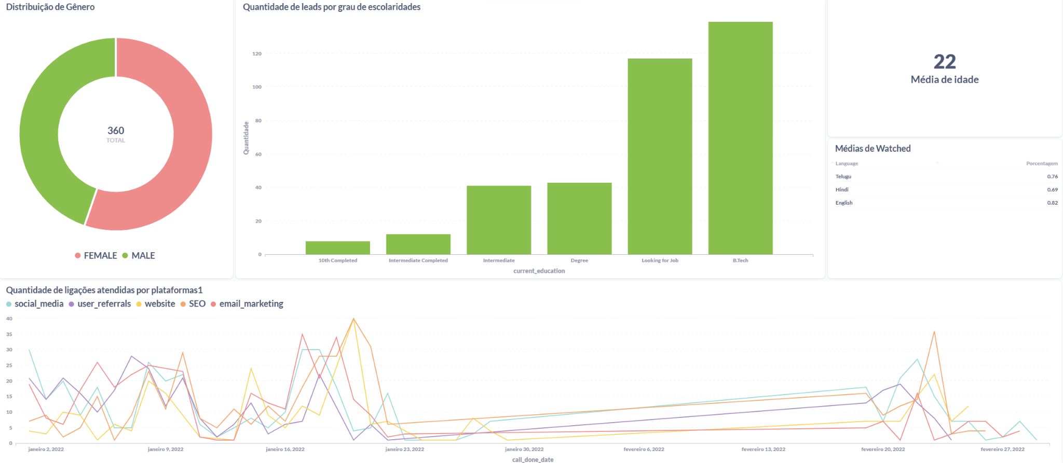
Dashboard

Slide 3
Gráfico 1 - (Gráfico de pizza)
Gráfico 2 - (Gráfico de barra)
Select gender, count(*)
from leads_basic_details
group by gender
SELECT `source`.`current_education` AS `current_education`, `source`.`Quantidade` AS `Quantidade`
FROM (SELECT current_education,
COUNT(*) as Quantidade
FROM leads_basic_details
GROUP BY current_education
ORDER BY current_education
DESC) `source` ORDER BY `source`.`Quantidade` ASC
Gráfico 3 - (Cartão)
Gráfico 4 - (Tabela)
Select avg (age) as
'Média de Idade'
from leads_basic_details
SELECT language as 'Language',
AVG(watched_percentage) as 'Porcentagem'
FROM leads_demo_watched_details
where watched_percentage > 0.5
GROUP BY language
ORDER BY 'Porcentagem' DESC;

Slide 4
Gráfico 5 - (Gráfico de linha)
SELECT `source`.`call_status` , `source`.`COUNT(*)` AS `COUNT(*)`, `source`.`call_done_date` AS `call_done_date`, `source`.`lead_gen_source` AS `lead_gen_source`
FROM (SELECT call_status, COUNT(*), call_done_date, lead_gen_source
FROM leads_basic_details
INNER JOIN leads_interaction_details
ON leads_basic_details.lead_id = leads_interaction_details.lead_id
GROUP BY call_status, call_done_date, lead_gen_source) `source`
WHERE `source`.`call_status` = 'successful'

